Slide 1
Data Transformation
Dplyr and the tidyverse

Slide 2
Workshop Objective
Understanding how to get data into R through csv, tsv import using the R input function
Understanding how to install and import the dplyr package
Understanding of the syntax in the dplyr package for filter, select, mutate and arrange
Complete the exercise with the data manipulation techniques
Notes:
https://www.datanami.com/2019/11/08/why-you-need-data-transformation-in-machine-learning/

Slide 3
Some Examples of Data Transformation / Manipulation
Remove unused and repeated columns
Change data types
Handle missing data (locf, nocb)
Remove string formatting and non-alphanumeric characters
Convert categorical data to numerical
Convert timestamps (PosIXT)
Notes:
https://www.datanami.com/2019/11/08/why-you-need-data-transformation-in-machine-learning/

Slide 4
How to get your data into R?
Use integrated dataset in R (iris, Cars, mpg etc)
Import csv (import dataset from the top right corner), read.csv()
Import excel spreadsheet (import excel from the top right corner), readxl()
Download dataset from CRAN
install.packages(Gapminder)
Download dataset from Bioconductor
BiocManager::install("airway")

Slide 5
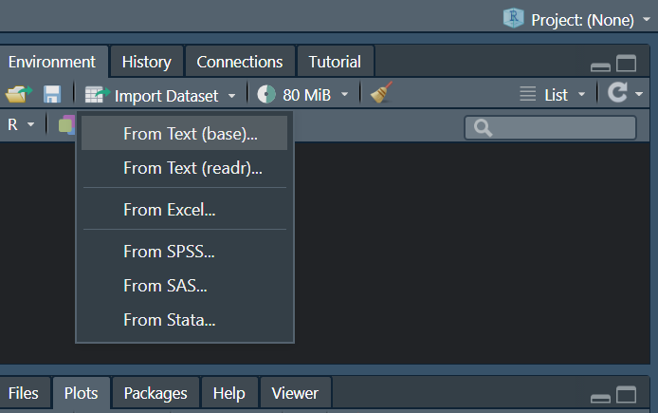
Import csv, tsv or excel in RStudio
Notes:
https://www.datanami.com/2019/11/08/why-you-need-data-transformation-in-machine-learning/

Slide 6
Download Data through the Googlesheet4
https://googlesheets4.tidyverse.org/
install.packages("googlesheets4")
library(googlesheets4)
read_sheet("https://docs.google.com/spreadsheets/d/1U6Cf_qEOhiR9AZqTqS3mbMF3zt2db48ZP5v3rkrAEJY/edit#gid=780868077")
Notes:
https://www.datanami.com/2019/11/08/why-you-need-data-transformation-in-machine-learning/

Slide 7
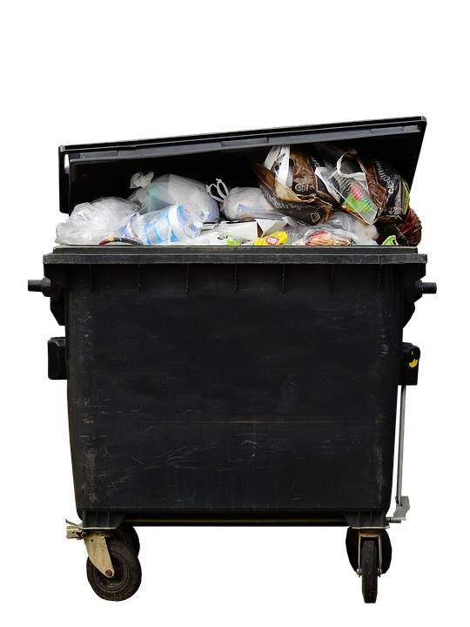
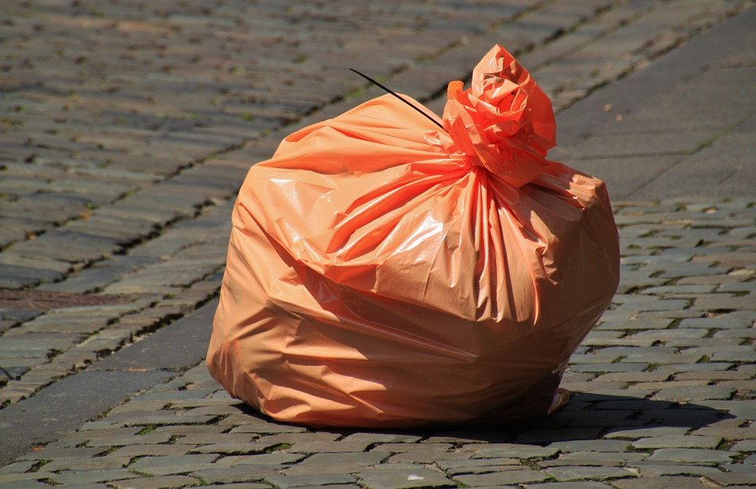
Garbage in , Garbage out

Slide 8
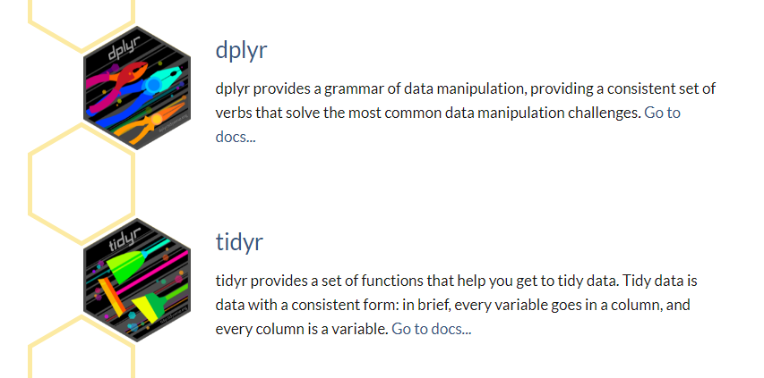
Tidyverse
The tidyverse is an opinionated collection of R packages designed for data science. All packages share an underlying design philosophy, grammar, and data structures.
Notes:
https://www.tidyverse.org/packages/

Slide 9

Dplyr (https://www.rdocumentation.org/packages/dplyr/versions/0.7.8)
dplyr is a grammar of data manipulation, providing a consistent set of verbs that help you solve the most common data manipulation challenges:
mutate() adds new variables that are functions of existing variables
select() picks variables based on their names.
filter() picks cases based on their values.
Summarise(), group_by() reduces multiple values down to a single summary.
arrange() changes the ordering of the rows.

Slide 10
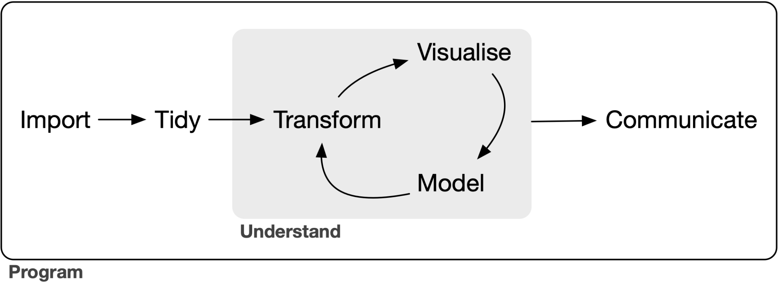
Workflow
Notes:
https://tidyverse.tidyverse.org/articles/paper.html

Slide 11
Installing packages
# The easiest way to get dplyr is to install the whole tidyverse:
install.packages("tidyverse")
# Alternatively, install just dplyr:
install.packages("dplyr")

Slide 12
A Recap in Data frame
A data frame is a table or a two-dimensional array-like structure in which each column contains values of one variable and each row contains one set of values from each column.
The column names should be non-empty.
The row names should be unique.
The data stored in a data frame can be of numeric, factor or character type.
Each column should contain same number of data items.
Notes:
https://www.tutorialspoint.com/r/r_data_frames.htm

Slide 13
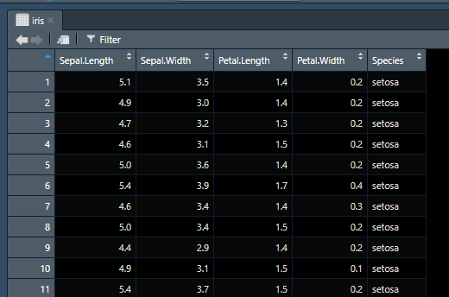
Dataframe structure is important for Dplyr

Slide 14
Using dplyr (https://www.rdocumentation.org/packages/dplyr/versions/0.7.8)
library(dplyr)
starwars %>%
filter(species == "Droid")
starwars %>%
select(name, ends_with("color"))
starwars %>%
mutate(name, bmi = mass / ((height / 100) ^ 2)) %>%
select(name:mass, bmi)

Slide 15
Using dplyr
library(dplyr)
starwars %>%
arrange(desc(mass))
starwars %>%
group_by(species) %>%
summarise(n = n(),mass = mean(mass, na.rm = TRUE)) %>%
filter(n > 1)

Slide 16
Let’s head to R

